Slide 1



Seattle Housing Market Study
View in Power BI
Last data refresh:
10/20/2017 11:55 PM UTC
Downloaded at:
10/21/2017 12:03 AM UTC

Slide 2
Seattle’s housing market has been claimed red-hot. What does the data say?
Is it a buyers market or sellers market?
What do I need to know if I want to buy a home in Seattle?
Is the bubble about to burst?
Is there an alternate choice closer by?

Slide 3
The source of the data is from Redfin’s data-center. The filtering uses only Single Family Home to give a uniform comparison.
Comparison is also made against a few other cities to obtain perspective and propose alternatives.
Tacoma, WA – To analyze and compare effect on a nearby city.
Portland, OR – To analyze and compare effect on the next closest similarly styled metropolis.
National – To give a baseline using US National average, to solidify the study.
Phoenix, AZ – To provide a comparison against a not so red-hot housing market, to offer perspective.

Slide 4
Sale Price Homes Sold Inventory and Days on Market - Compared

Slide 5
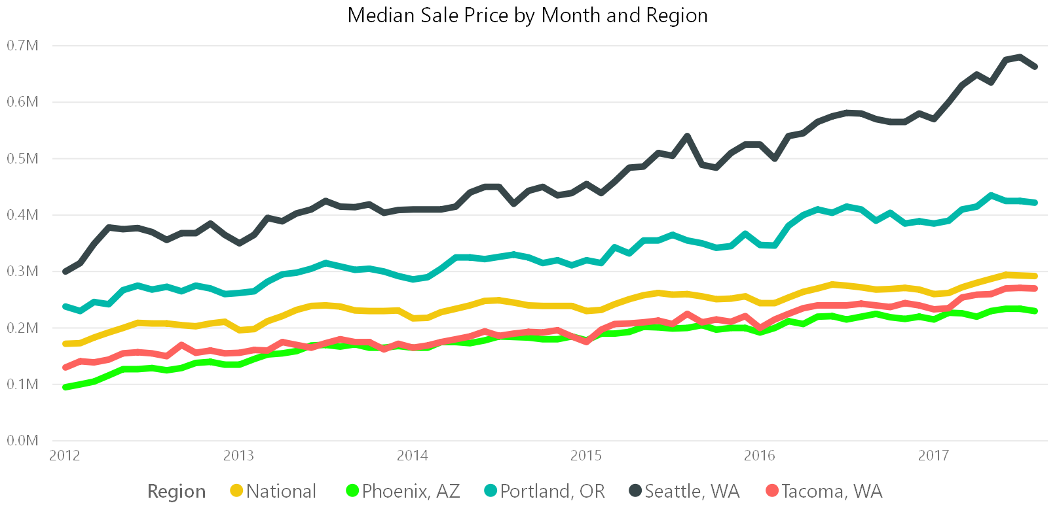
Median Sale Price by Year
Seattle tops the list. Highest YoY growth from 2012 to 2017. More than doubled.
2017 growth is tremendous. Way higher than any comparable cities.
Tacoma feels the ripple effect of Seattle growth in 2017. Median Sale prices are very close to National average in 2017. Would likely surpass it pretty soon.
Portland also feeling the Seattle growth effect. 2016 and above growth trajectory is as close as Seattle.

Slide 6
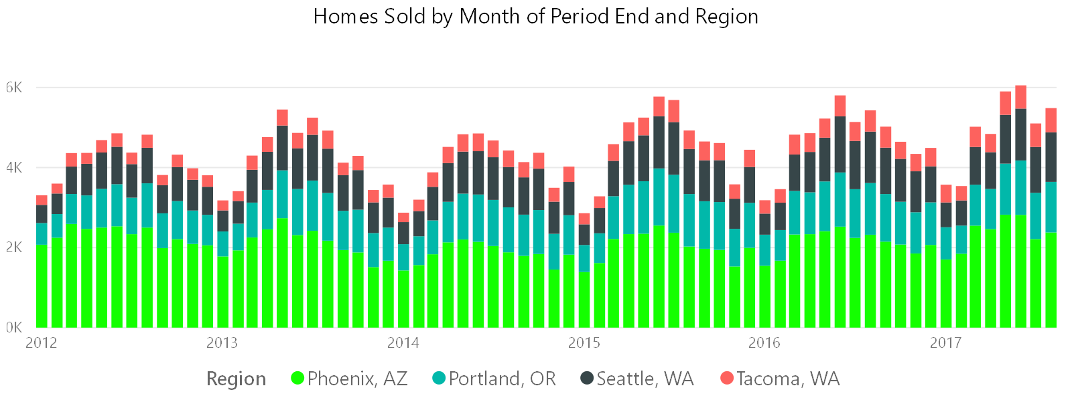
Homes Sold by Year
Seattle has a low volume of homes sold, even when compared to Portland – pointing towards a overall short supply in the region.
A very interesting sinusoidal wave pattern – More houses are sold in the middle of the year. Likely because of summer break favoring movements.

Slide 7
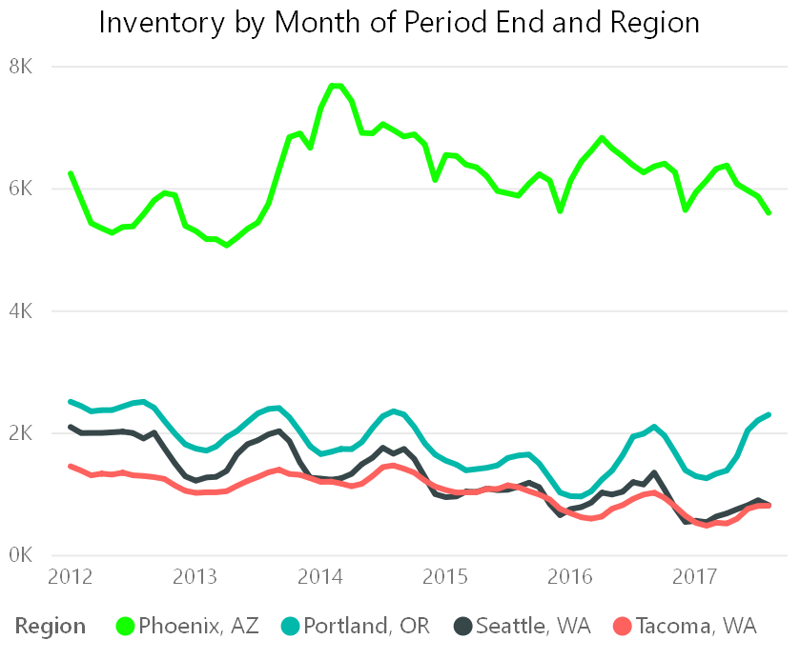
Inventory by Year
Inventory continuous to drop down steadily in Seattle. Despite being a bigger metropolis than Tacoma, after 2015 inventory falls below the numbers of Tacoma at times.
Portland continuous to maintain a very healthy inventory. Showing good signs of supply, for the demand it gets.

Slide 8
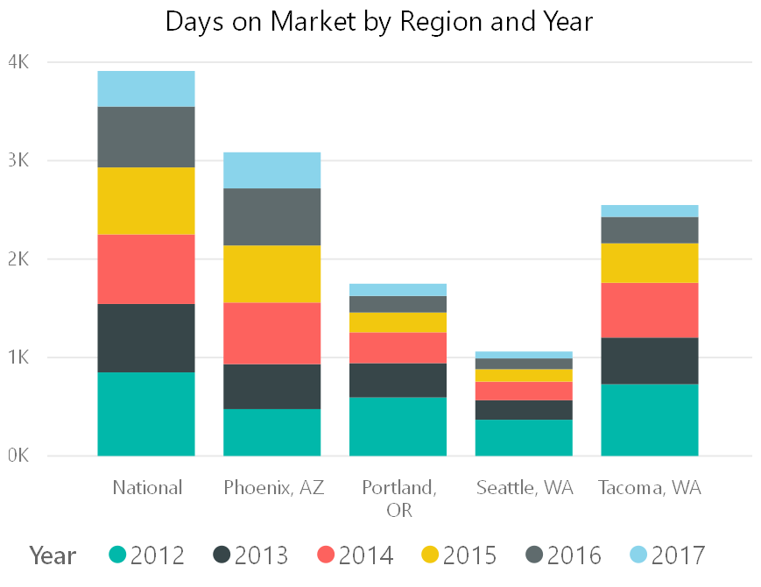
Days on Market
And the kicker – despite the high price, and dwindling inventory, deals are getting closed at a rapid pace. Through the years, the number of days a house remains in the market is lower than any comparison.
The average days on market for a home in Seattle on 2017 is mere 8.5 days, compared to a national average of 45 days.

Slide 9
Also there’s a clear inverse relation between Price vs Days in Market.
Can we tell a story? Here’s a scatter plot showing how aggressive the market is.
Especially for Seattle, price keeps moving up in the Y-Axis, while the Days in Market keeps decreasing left in the X-Axis.

Slide 10
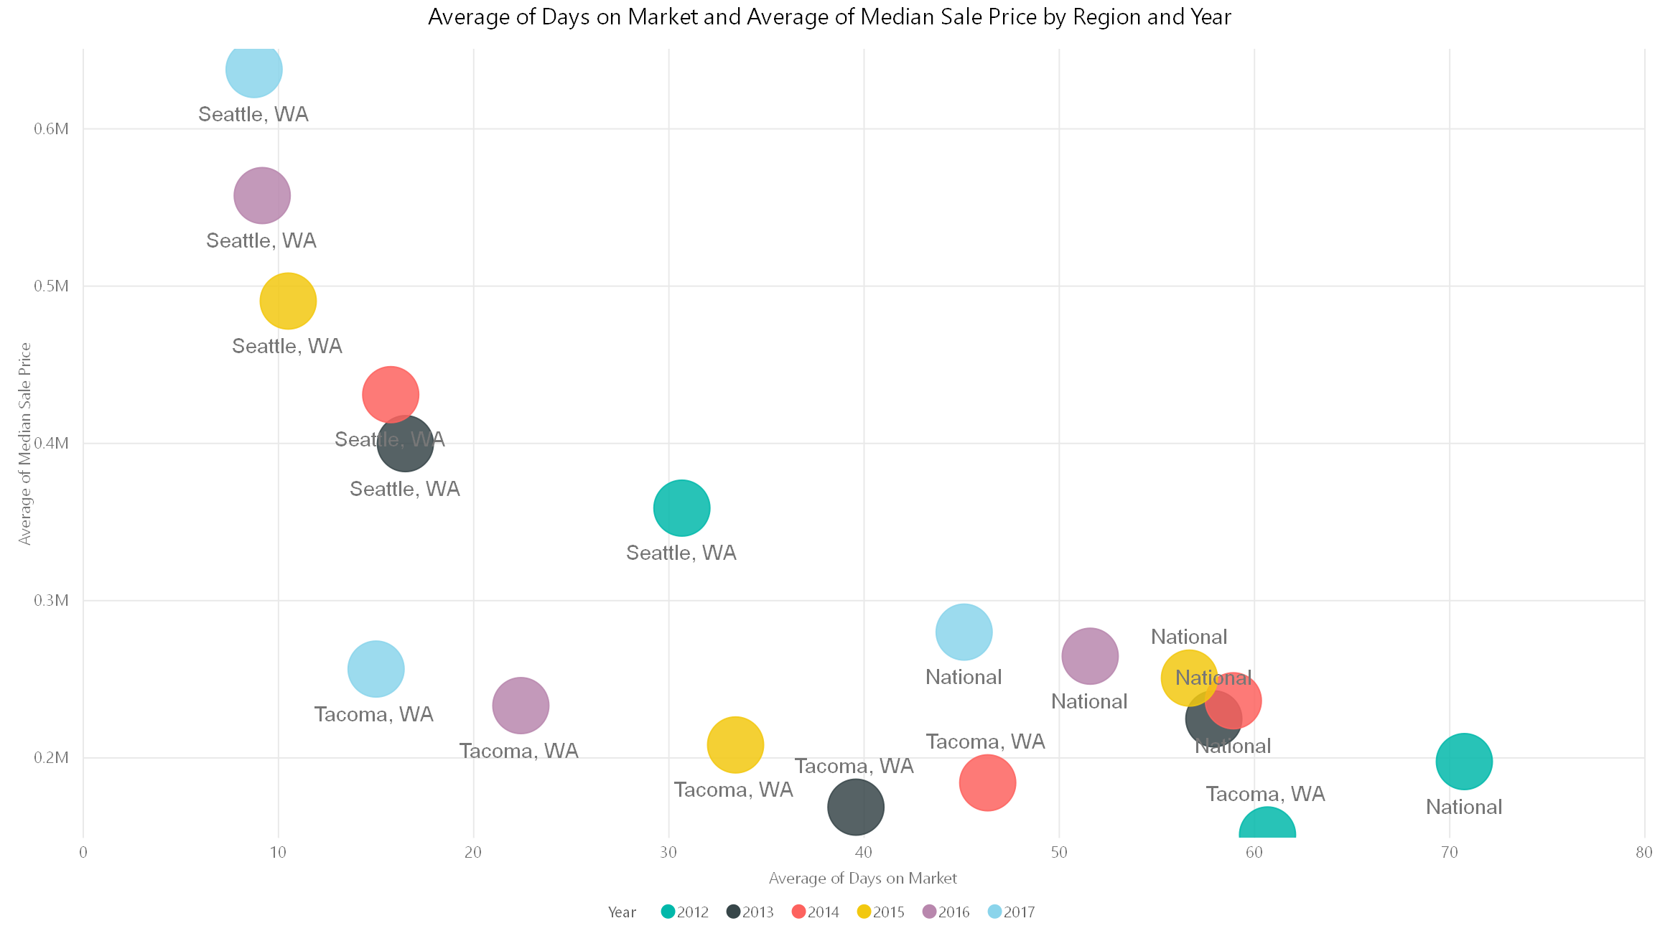

Slide 11
And finally, what’s a story without a video?
Here is a video showing the monthly movement in a scatter plot playing along from Jan 2012, and all the way to August 2017 illustrating our thesis.

Slide 12
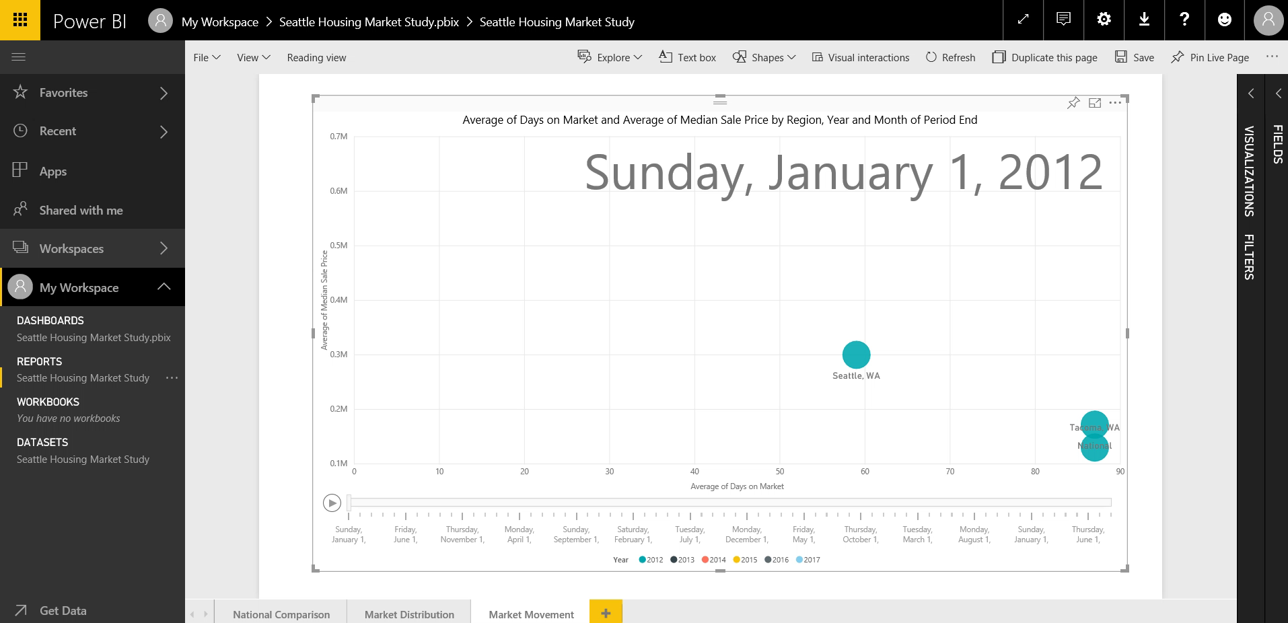

Slide 13
Conclusion
Let’s try to answer the question that was posted in our problem statement.
Is it a buyers market or sellers market?
Sellers. There is no healthy supply for buyers and price is way too high, that too if some one can close in 8 days.
What do I need to know if I want to buy a home in Seattle?
Be aggressive. Homes could be hard to find, and will get closed even before reacting. Try to approach during the summer, when the inventory and homes sold is little higher.
Is the bubble about to burst?
It’s hard to say, but likely. Unless there is a regulation to improve things, it’s an alarming ratio to sustain.
What are my alternate choices?
Tacoma, WA has a healthy inventory to price ratio. Portland, OR is a better value proposition too.

